Slide 1

Department of Electrical and Electronic Engineering (EEE)
A Simple Analog Gas Detection System for Safety Monitoring
Submitted to:
Md. Sharif Uddin
Lecturer, Department of EEE
University of Asia Pacific
Date of Submission: 26 October 2025

Slide 2
🔹 What is a Gas Detector? A gas detector is a device that senses harmful gases in the air and alerts when the gas level becomes unsafe.
🔹 Objective of the Project:
To build a simple and low-cost gas detection system.
To detect gases like LPG, Methane, or CO.
To give alarm using LED and buzzer.
To improve safety in homes and industries.
🔹 Importance / Applications:
Helps prevent fire or gas explosion.
Ensures safety in kitchens and factories.
Can be used in smart home safety systems.

Slide 3
⚙️ Components Used
“These are the main components I have used in my project.”
LM393 Comparator
MQ-2 or MQ-135 Gas Sensor
Resistors
LEDs (indicator)
Buzzer (for alarm)
Buck Converter (5V Regulator) – Steps down voltage for stable power supply.
Arduino UNO
Used to demonstrate how the comparator and circuit work.
Helps to easily monitor sensor output and fault conditions.
Makes testing and debugging simple.
The circuit can also work independently without Arduino.

Slide 4

LM 393 Comperator

Slide 5


Comperator OUTPUT
HIGH
LOW

Slide 6
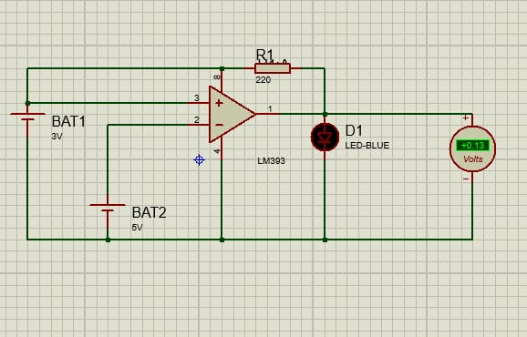

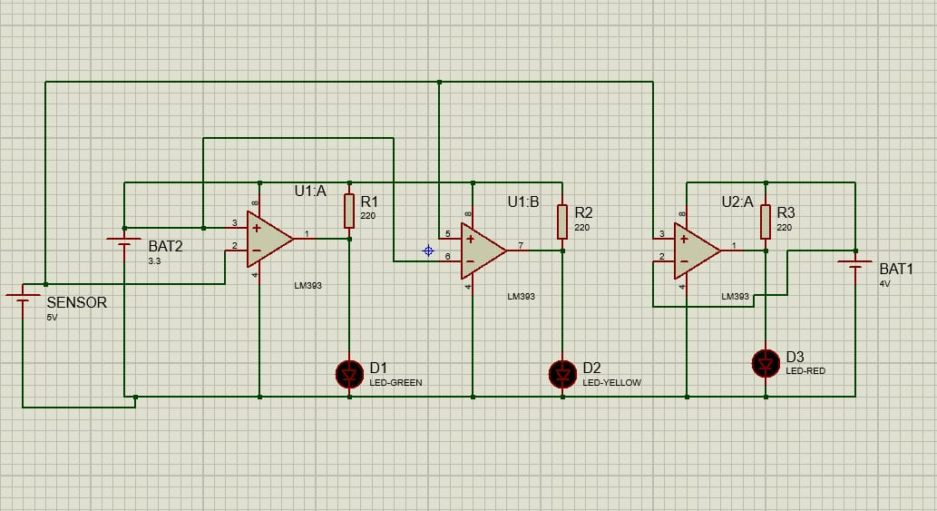

Slide 7
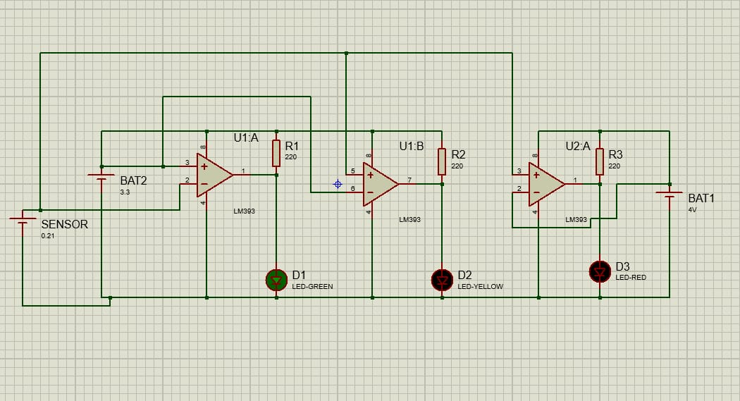

Slide 8
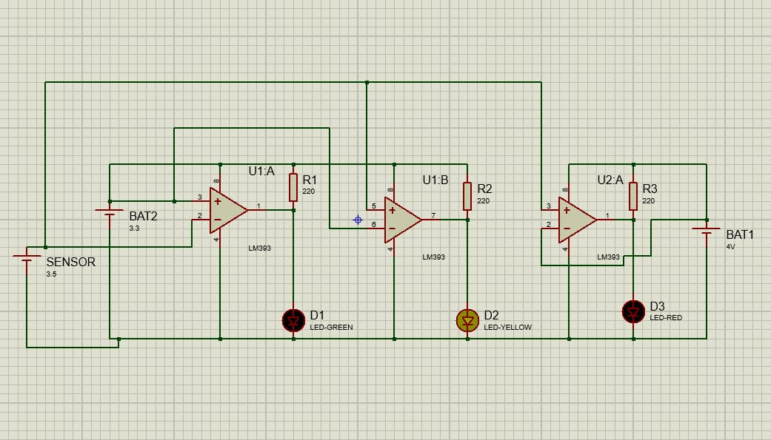

Slide 9
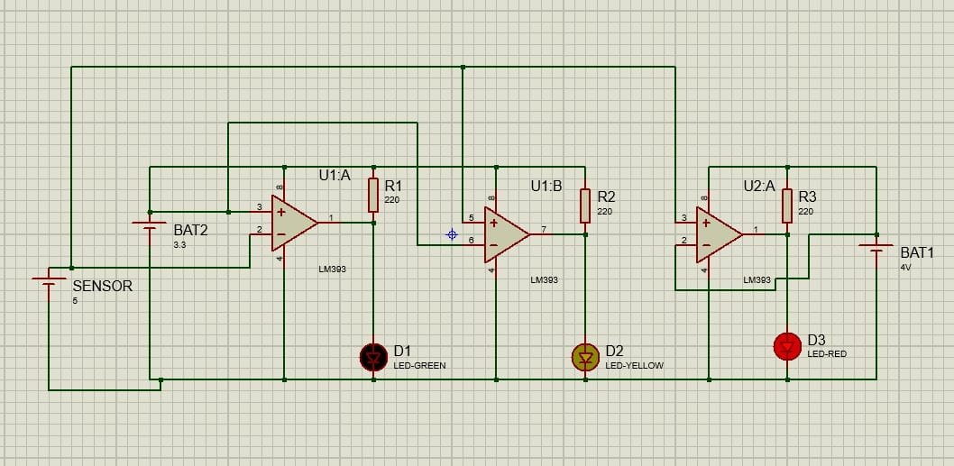

Slide 10
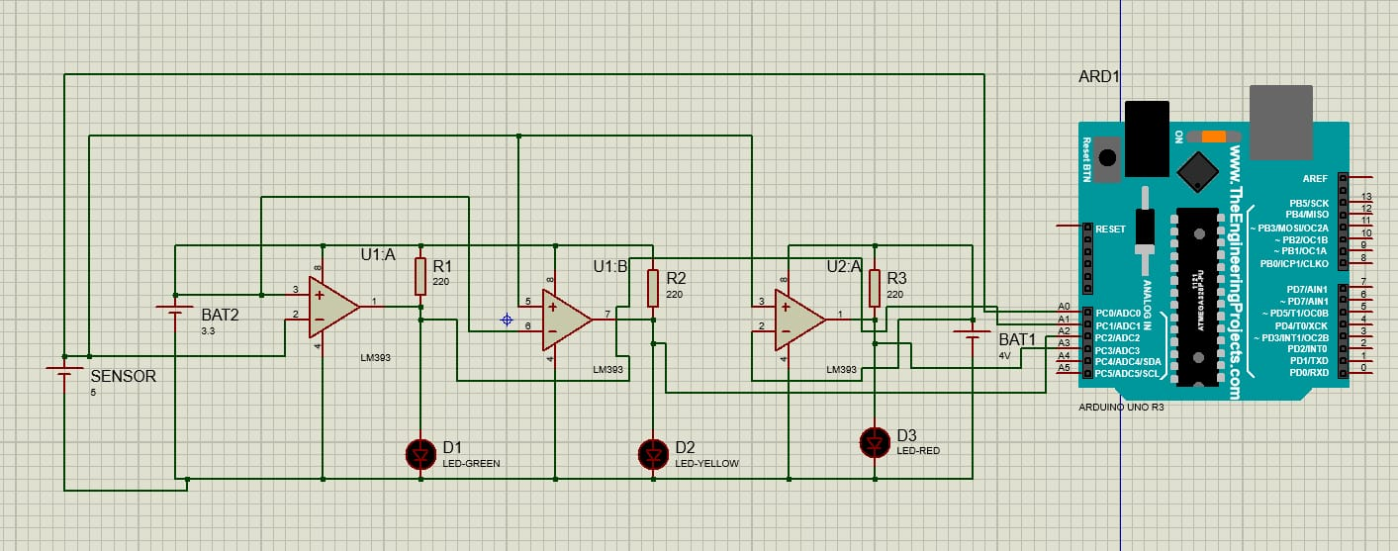

Slide 11
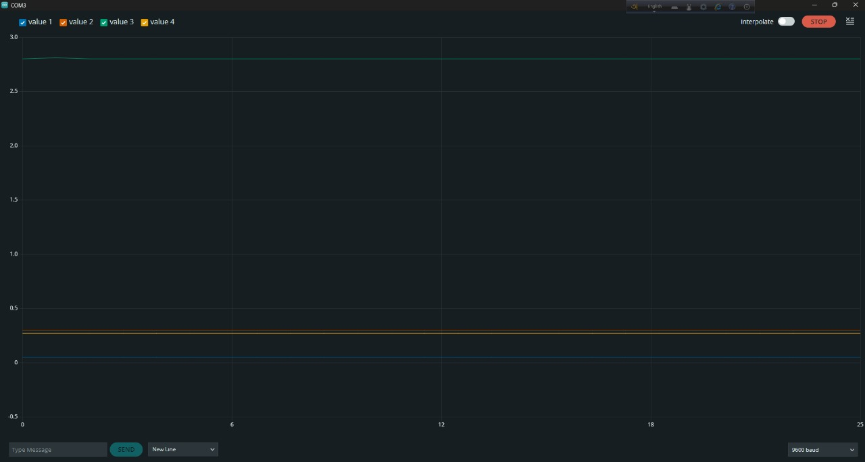
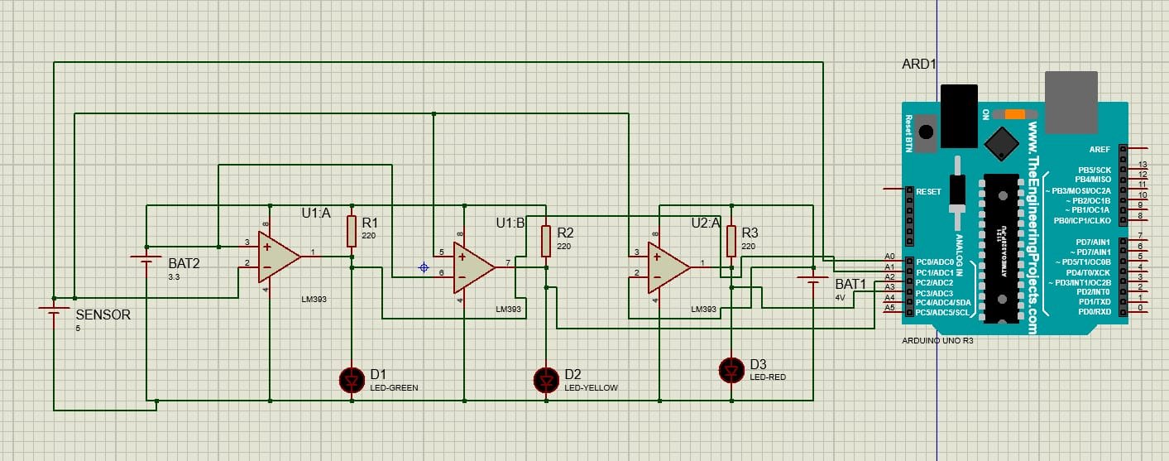
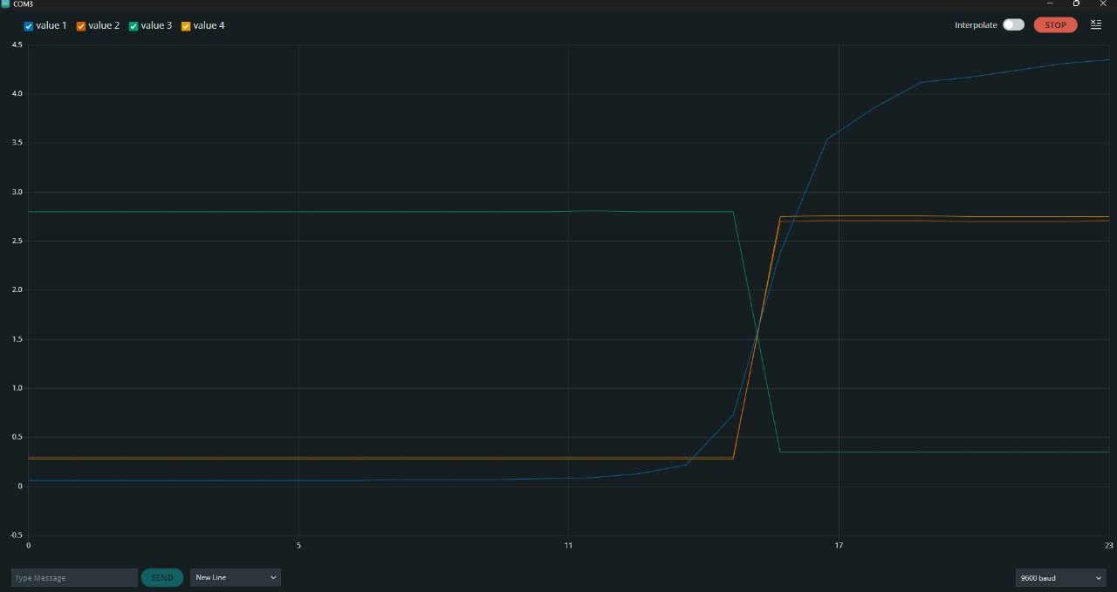

Slide 12
Problems Faced
1️⃣ Previous Circuit Issues:
Tried using 555 timer + OP-AMP + BJT + Diode circuit.
Switching was not reliable.
Diode voltage drop too low → incorrect triggering.
2️⃣ Sensor Problems:
One sensor got completely damaged.
Another sensor had high initial voltage that kept increasing on each test.
Sensor replaced with a better model for accurate detection.
3️⃣ New Circuit Design:
LM393 comparator-based circuit used for stable HIGH/LOW output.
LED & buzzer trigger reliably.

Slide 13
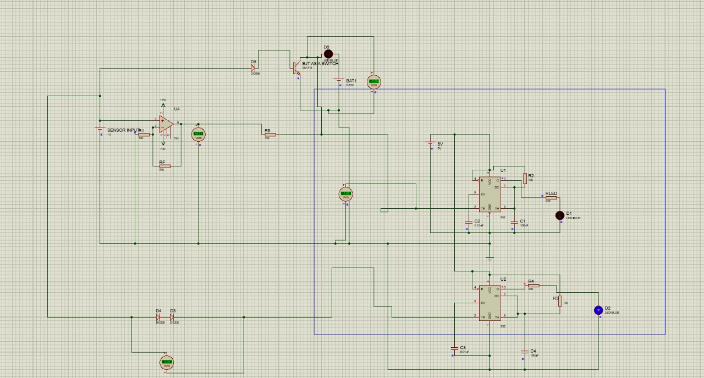

Slide 14
📈Applications:
“This system can be used in homes, industries, and laboratories for safety purposes.”
LPG leakage detection
Industrial gas monitoring
Fire prevention systems
Smart home safety devices

Slide 15
💡Advantages & Limitations
Advantages:
Low cost
Simple circuit
Real-time response
Limitations:
Needs calibration
Sensitive to humidity and temperature

Slide 16
Conclusion:
“In conclusion, this gas detector sensor is a simple, low-cost system that can play a vital role in detecting harmful gases and preventing accidents.”
Acknowledgment:
I am thankful to my course teacher Md. Sharif Uddin &
Proctor sir Md. Khairul Alam for the constant guidance and
support.
Thanks to my Group member and the Project Lab, UAP, for their help during the development and testing of my project.

Slide 17
🔹 Future Work (Fire Fighting BOT)
Make a small moving vehicle that can find gas leaks and fire.
Vehicle will send alerts when it detects danger.
Try using special frequencies to help reduce fire.
Connect to phone or computer to see alerts.
Useful for home and factory safety.
Use special sound waves to help put out fire.

Slide 18
Team Member ID and Name
Contribution
1. Orghojit Pal Tonmoy (ID: 23208031)
Component selection, oscilloscope,Data Collection
testing,Documentation, result analysis,
Circuit design & simulation(Protius),
PCB design(EasyEDA), Verify Circuit Working(Aurdno)&
Coding(Aurdno IDE),Presentation preparation(Keynote),
Assembly circuit.
2. Md Asadus Zaman Emon (ID: 23208052)
3. Ferdous Hossain (ID: 23208008)
Presentation preparation, report writing, block
diagram,Assembly Circuit.
Documentation, simulation, result analysis,Coding
Result Analysis
4. Nafiza Anzum Zeba (ID: 23208002)

Slide 19

The complete documentation, source code, and circuit design for this project are available on my GitHub repository.
It can be used as a reference by students or hobbyists who wish to create a similar gas detection system.
Repository Link:
https://github.com/XunidEmon

